Slide 1
Expensive restaurant and health inspections scores.
Group 5
Weylin Lam
Devin Milligan
Nancy Mathur
Christian Thomson

Slide 2
Why do you care?
Why we chose this topic
We wanted to know if price is related to the outcome of a Health Inspection
Notes:
We believed that restaurants that cost more had better health inspection scores
We all deiced that the biggest thing we had in common was food.
Portland is a foody town
We like to eat
Perception of higher cost = better experience

Slide 3
Our Hypothesis
Restaurants that are more expensive have higher health inspection scores.

Slide 4
Our process
Started to read the documentation
Tried to understand what information we got back
Changed our scope once we looked at the data in more depth
Decided on our data sources
County website
County CSV
Yelp API
Looked at Health Inspection scores / Price rating
Distribution of inspect to rating
Distribution of restaurants with similar scores
Notes:
Call out the county was able to give a CSV file

Slide 5
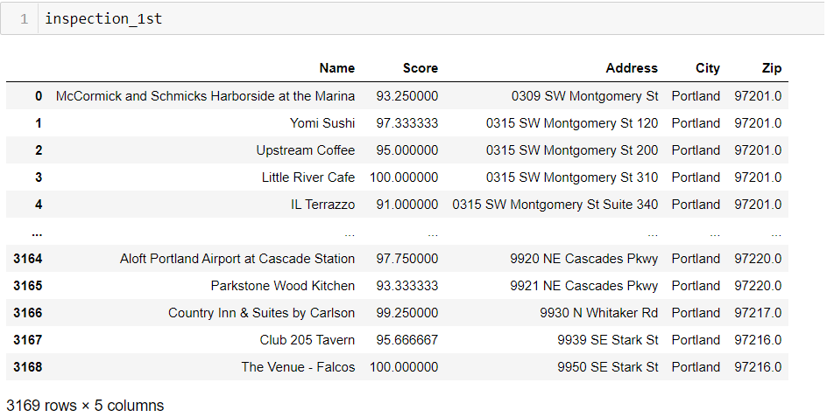
We got a CSV from the County
Notes:
This is our CSV from Multnomah County
Made into a data frame
Note : 3200 Rows
Painstakingly provided to us by Christian

Slide 6
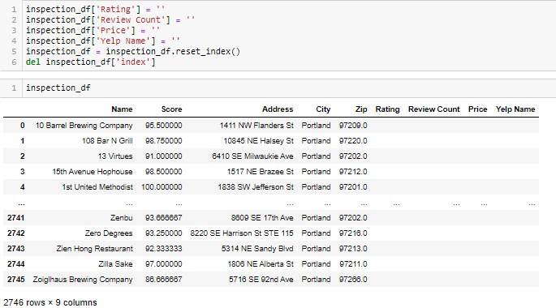
We needed more columns
Notes:
Made room for data we get from API via making new columns
We lost rows, down about 500 via DropNA and DropDuplicates

Slide 7

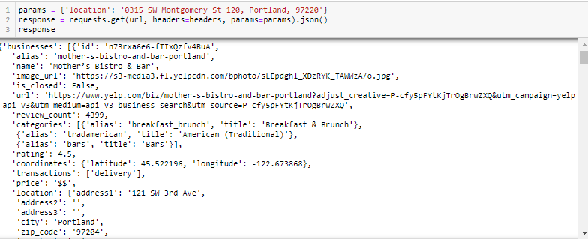
We used
Notes:
Started to use the physical address as a params in the Yelp API
Was returning Erroneous Data so we had to pivot

Slide 8
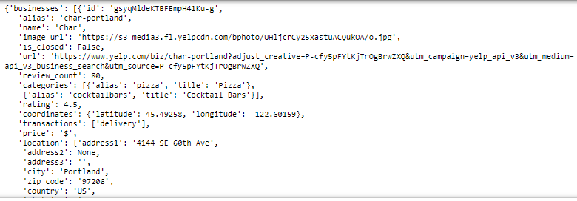
We changed direction
Notes:
Another Example of an API call after using different parameters
Which I will explain in the next slide

Slide 9
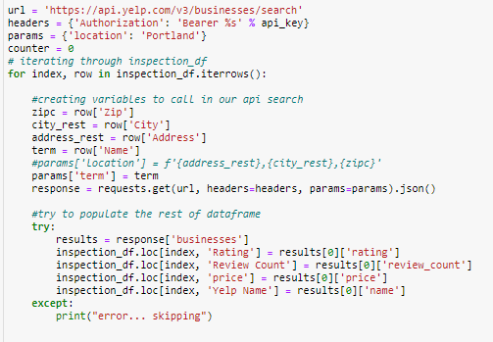
We asked the world for results
Notes:
Used Portland for the Location Parameters
Used iterrows to gather and store information in our dataframe
In combinaton with the location parameter we used the terms parameter
Got us much more accurate results
Used Try Except to store information in data frame from the API
Except skipped rows where we could not get information from the API

Slide 10
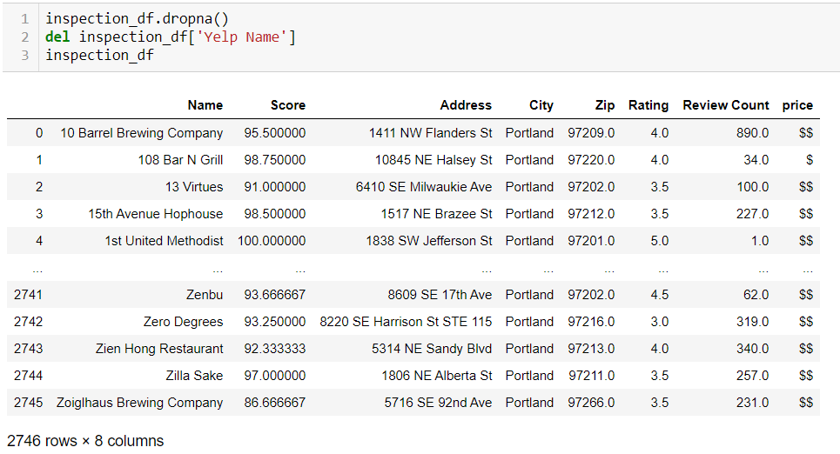
We added some data to columns

Slide 11
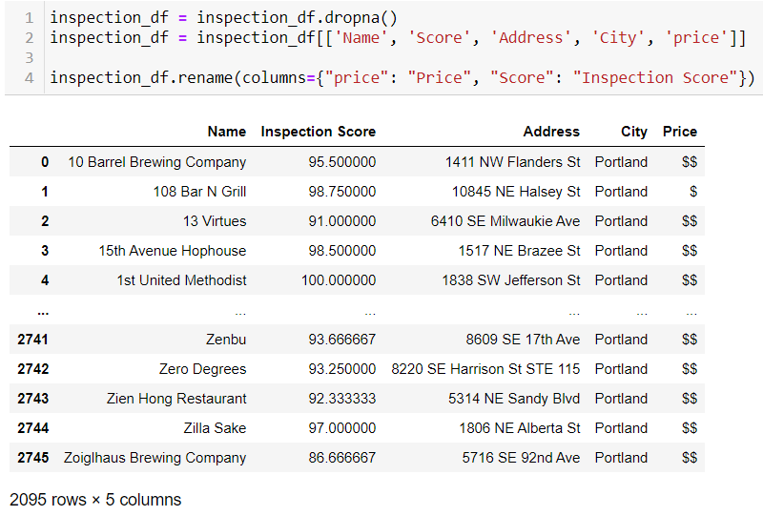
We got rid of rows with not enough info our Data is clean!
Notes:
Cleaned up the DataFrame a bit
Deleted Columns
Renamed others
Dropped Rows that were skipped in the for loop
Next is our Resident Visualization and Analysis Correspondent, Nancy, to tell you a little bit about our findings

Slide 12
We started to look at our results
Graphically
Numerically
Figuratively

Slide 13
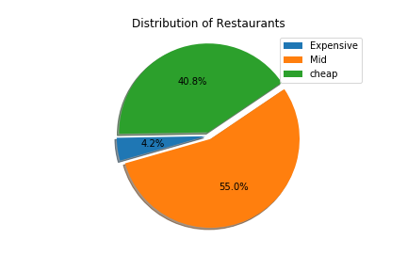

Slide 14
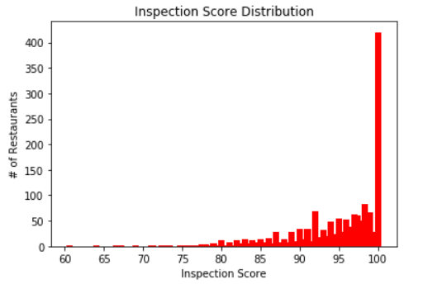

Slide 15
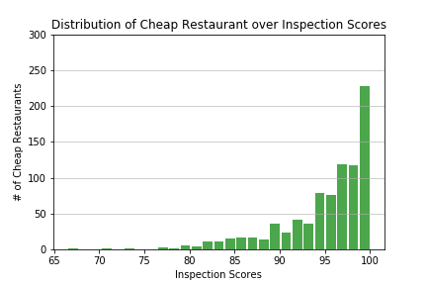
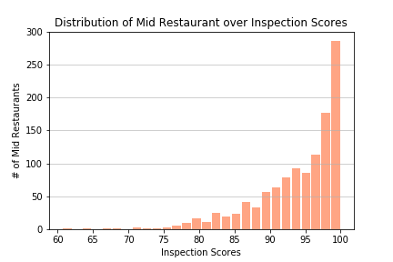
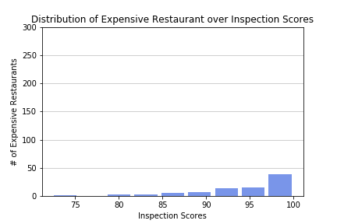
Notes:
85.49% data lies btw 90 and 100 inspection score for cheap
79.6% data lies bet 90 and 100 inspection score for mid
79.3% data lies btw 90 and 100 for expensive

Slide 16
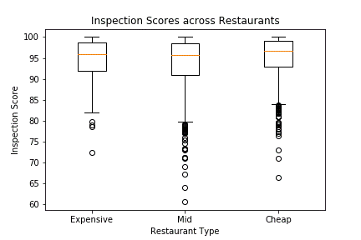
Notes:
Min for exp is 72. Min for mid is 60. Min for cheap is 66.

Slide 17
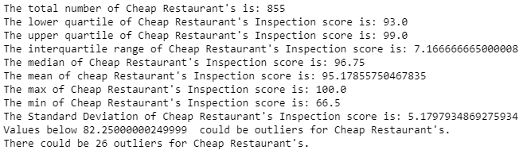
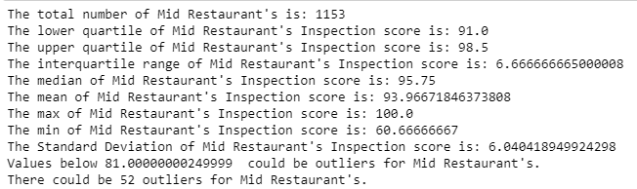
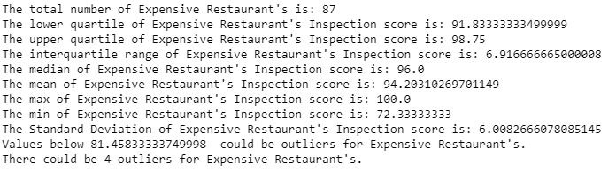
Cheap
Mid
Expensive

Slide 18
What it looked like
https://github.com/DCMilligan88/Project1Repo/blob/nancybranch/analysis_project1.ipynb

Slide 19
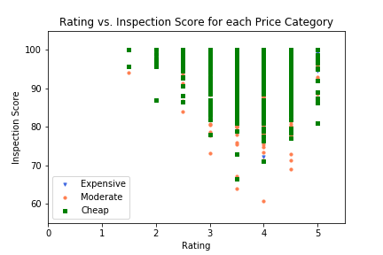
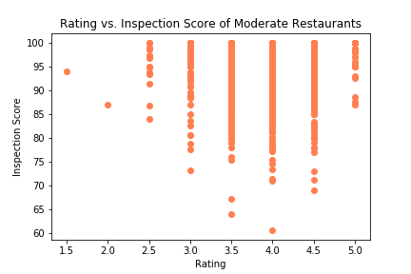
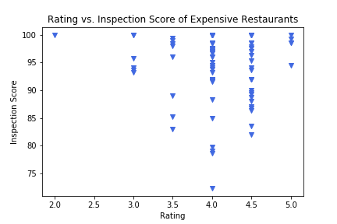
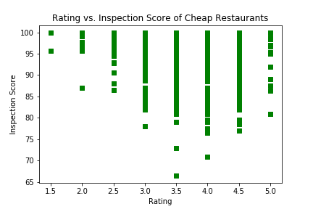
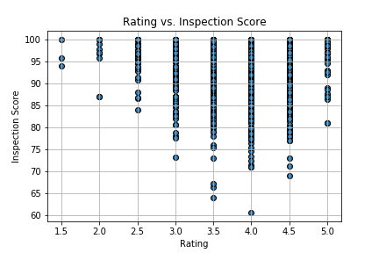
Didn’t think that would happen?

Slide 20
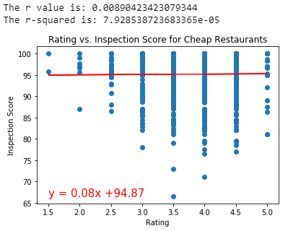
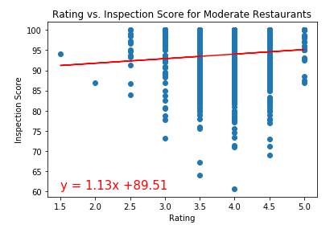
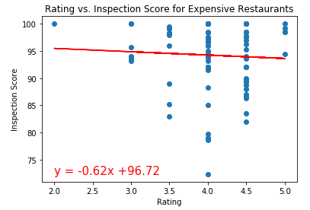

Slide 21
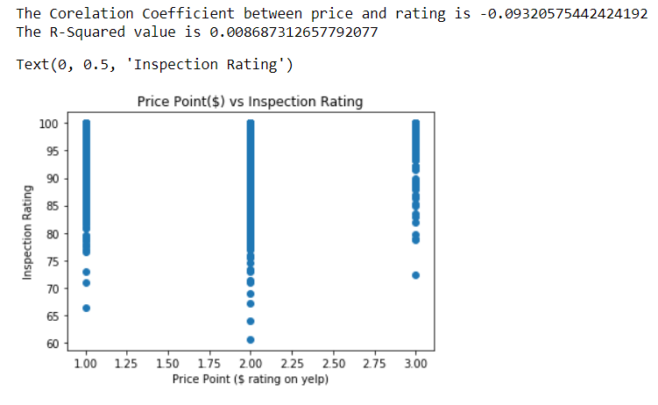

Slide 22
Why we are right if we are?
Our assumption was the more expensive a restaurant is the better the health score.
What we found was 87 business with an Expensive rating had an average scored of 94% on a health inspection
We found that 855 business with cheap rating had an average scored 95% on a health inspection
We found that 1153 business with a Mid rating had an average scored 94% on a health inspection

Slide 23
Memories
Things that well
Things that happened
Things that became a pain
Notes:
Found Data when we asked.
I think the team worked well together
Delegated strengths
Our scope
Misunderstanding
Not as many expensive restaurants
Git bash
Conflict errors
Understanding yelp API restrictions

Slide 24
What do we wish we could have looked at
More data

Slide 25
Eureka!
Insights you had while exploring the data that you didn't anticipate
It just doesn't matter

Slide 26
Thank you for your time
Questions?

